Slide 1
Pension schemes for civil servants and public-sector workers
Options for reform
Edward Whitehouse
Social Policy division
OECD
International Workshop on Civil Service
and Military Pension Arrangements
Hitotsubashi University
Tokyo, January 2011

Slide 2
Agenda
Institutional arrangements for public-sector workers’ pensions
Demographic pressures
Flexibility and portability of civil-service pensions

Slide 3
Origins
Civil-service pension schemes usually set up before national programmes
independence of civil servants
make working for the public sector attractive
shift the cost of remunerating civil servants into the future
Separate schemes then often persisted after national schemes established: ‘dualism’

Slide 4
Institutional arrangements around the world
South Asia
7
Africa
32
7
Middle East/
7
4
North Africa
East Asia
9
6
Separate
Integrated
OECD
13
12
Latin America/
12
15
Caribbean
Eastern Europe/
27
Central Asia
0
25
50
75
100

Slide 5
Institutional arrangements
Fully
Integrated
Estonia
Hungary
Latvia
Lithuania
Slovak R.
Slovenia
Czech R.
Poland
Separate
but similar benefits
Denmark
Finland
Iceland
Netherlands
Sweden
Fully integrated with
top-up
Canada
Spain
United States
Ireland
Japan
Norway
Switzerland
____________
Italy
New Zealand
Partially
integrated
with top-up
Australia
United Kingdom
Entirely
separate
Germany
Austria
Belgium
Korea
France
Greece
Luxembourg
Portugal
Turkey

Slide 6
Dualism
Arguments against
Integration gives civil servants direct, personal interest in the plan being well managed
Economies of scale
Mobility and portability
Equity
Transparency
Long-term goal should therefore probably be integration of civil-service and national pension plans

Slide 7
Demographic pressures
Civil service schemes have a different demography from the population
‘Ageing’ will affect civil service schemes earlier because of past recruitment policy
civil services expanded rapidly in the 1960s and 1970s
growth has slowed and sometimes come to a halt in the 1980s and 1990s

Slide 8
Central government employment
per cent of total population

Slide 9
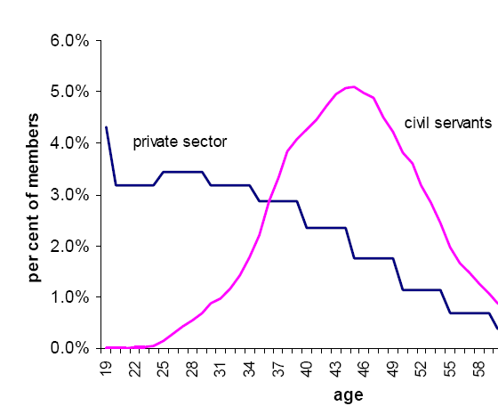
Example: Brazil

Slide 10
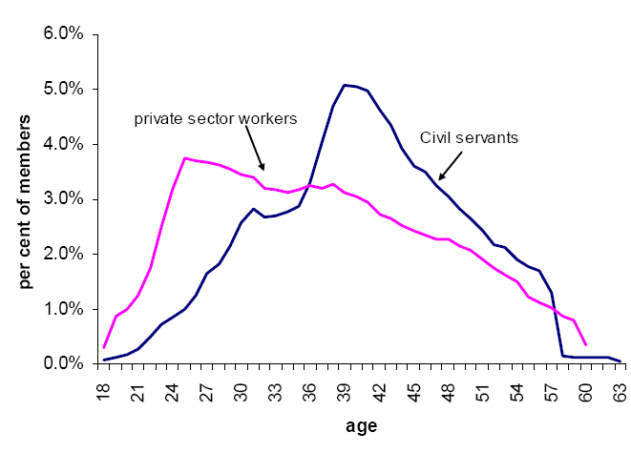
Example: Egypt

Slide 11
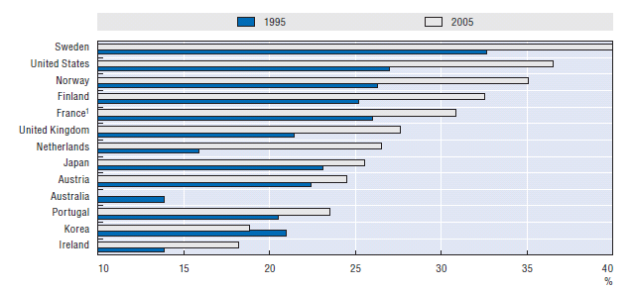
Demographics: Civil servants aged over 50

Slide 12
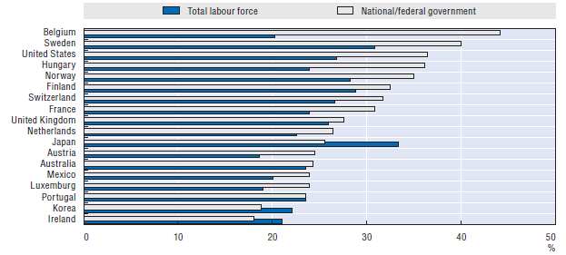
Demographics: Over 50s in the workforce

Slide 13
Reforms
‘Parametric’ reforms to defined benefit plans
reduce replacement rate
index pensions in payment to prices rather than civil-service earnings
introduce/increase member contributions
raise pensionable age
extend averaging periods for ‘final’ salary
‘Systemic’ reforms
introduce new system for new civil servants with some element of pre-funding of obligations
Any reform must take account of all aspects of civil-service terms and conditions

Slide 14
Raising retirement age
Civil service schemes are ‘closed’ systems
so increasing retirement age has different effects than it does in national schemes
labour supply effect in national schemes
Increase in retirement age cuts duration of benefit payments, but
without downward adjustment of accrual rates to compensate, benefit values increase
people might retire on higher pay if earnings continue to grow with age
affects both pay and pension bills

Slide 15
Flexibility and portability
Civil service schemes are inflexible: ill designed to deal with people without full careers
But flexible schemes are increasingly important
‘revolving doors’: cross-fertilisation between public and private sectors
transfer of employees due to privatisation or contracting out

Slide 16
Penalties to moving jobs
Vesting periods: when individual qualifies for a pension
<1 year in Finland, Netherlands, Sweden, Switzerland, UK
5 years in Belgium, Germany, Ireland, Italy
15yrs in Austria, France, Spain, Mauritius, Senegal
people can leave with nothing
Treatment of ‘early leavers’: what happens to the benefit between leaving the job and claiming the pension?
full transferability (Finland, Netherlands, Sweden) moves to occupational plan with same benefits in private sector
full preservation (France) accrued rights uprated in line with civil-service earnings
In other countries, a pension cost to moving jobs

Slide 17
Example: Mauritius
Value of accrued
pension
25
30
35
40
45
50
55
60
age

Slide 18
Example: Mauritius
Value of accrued
pension
Staying to retirement:
1/50th of final salary
25
30
35
40
45
50
55
60
age

Slide 19
Example: Mauritius
Value of accrued
pension
Staying to retirement:
1/50th of final salary
Lump sum
Deferred pension:
1/50th of current salary
25
30
35
40
45
50
55
60
age

Slide 20
Example: Mauritius
8
Cost of leaving,
proportion of
earnings
6
4
2
0
25
30
35
40
45
50
55
60
age

Slide 21
Example: UK
Cost of leaving,
1.5
proportion of
earnings
1
.5
Early leaver’s benefit depends on
earnings uprated in line with prices:
‘partial preservation’
0
25
30
35
40
45
50
55
60
age

Slide 22
Germany
Cost of leaving,
6
proportion of
earnings
4
2
Early leaver is retrospectively transferred to national scheme with lower benefits
0
25
30
35
40
45
50
55
60
age

Slide 23
Conclusions: reforms to improve portability
Shorten vesting periods
Preserve pension rights of early leavers
Extend averaging period for ‘final salary’
career average uprating eliminates the mobility problem
also deals with problems of incentives for abuse
but requires improvements in record-keeping
Introduce a defined contribution scheme
fully portable
examples include Australia, UK, US
Merge schemes for different public-sector workers
Move to a single national scheme
equity as well as efficiency

Slide 24
Conclusions: reforms to improve finances
Introduce or increase employee contributions
Increase pension age: but take care
Change incentives for early/late retirement
Change indexation procedures
Move to more targeted provision
Link benefits to life expectancy

